Slide 1


How Comcast Turns
Big Data into Real-Time Operational Insights
Copyright © 2012 Splunk Inc.
Raanan Dagan, Big Data Solutions, Splunk
Patrick Shumate, CDN Engineering, Comcast

Slide 2


What We’ll Talk About
Supporting the Anytime, Anywhere Network
Splunk and Big Data
Comcast’s Universal Database Initiative
Going for Gold – the London Olympics

Slide 3


Company
  Founded 2004, first software release in 2006
  HQ: San Francisco, CA
  Regional HQs: Hong Kong, London
  Over 600 employees, in 8 countries
4,400+ Enterprise Customers
  Customers in over 80 countries
  54 of the Fortune 100
One of nation's leading
providers of entertainment, information & communications products and services

Slide 4
The Comcast Cable Team
Product
Engineering
Product
Application
Services
Video
System
Services
CDN
Engineering
Search VSS: Centralized machine data collector for real-time monitoring, analytics, event correlation, reporting and dashboards
CDN Engineering: Software Development, Selection and Management Across Services

Slide 5




Supporting an Anytime, Anywhere Network
Notes:
What’s the overall problem Comcast is trying to solve with UDB and what are the challenges:
Deluge of data – most of it in application logs
Data is difficult to understand and in silos.

Slide 6
The Challenge

Slide 7
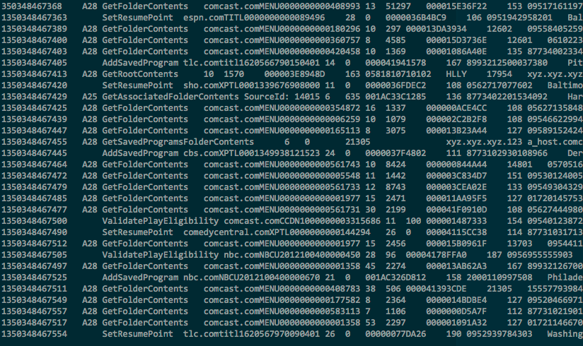
Comcast – UDB Before Splunk
Turning This

Slide 8
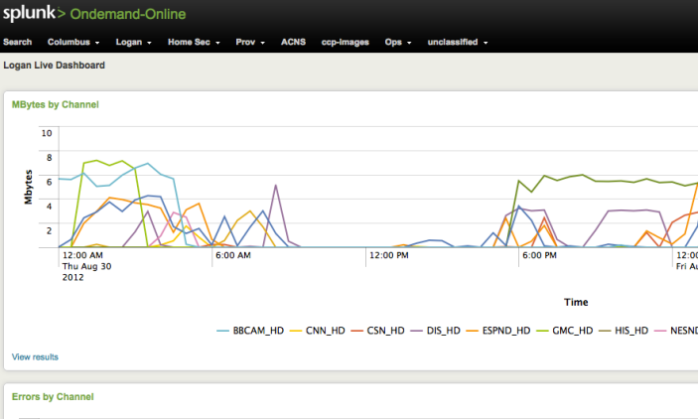
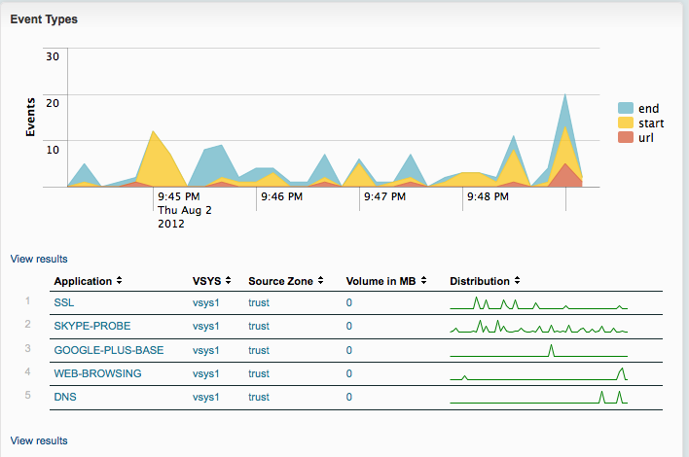
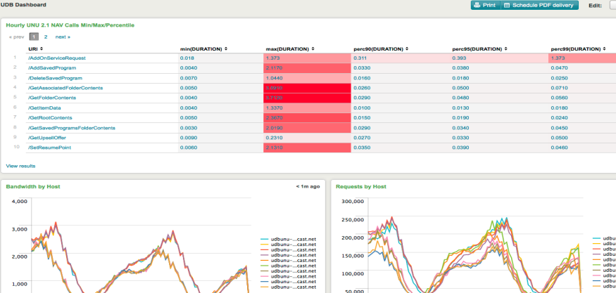
To These

Slide 9
Requirements for Universal Database
Caller ID
Metadata Distribution
STB
Menus
Menu
Entitlement
Universal Database
(UDB)
Input Requirements
Output Requirements
High volume of data from many systems along a complex workflow
Developers expressing artistic prerogative on log formats
Many different data sources and formats
Drive operational intelligence
Improve user experience
Troubleshooting, root cause analysis
Track and measure success
Reports, alarms

Slide 10
Big Data Comes from Machines
Volume | Velocity | Variety | Variability
Machine-generated data is one of the fastest growing, most complex
and most valuable segments of big data
GPS,
RFID,
Hypervisor,
Web Servers,
Email, Messaging
Clickstreams, Mobile,
Telephony, IVR, Databases,
Sensors, Telematics, Storage,
Servers, Security Devices, Desktops
Notes:
let’s examine for a second, one of the fastest growing, most complex and most valuable segments of big data – machine data. All the webservers, applications, network devices – all of the technology infrastructure running your enterprise – generates massive streams of data, in an array of unpredictable formats that are difficult to process and analyze by traditional methods or in a timely manner.
Why is this “machine data” valuable? Because it contains a trace - a categorical record - of user behavior, cyber-security risks, application behavior, service levels, fraudulent activity and customer experience.
For Splunk the last two Vs are very important. Variety of data + Variability of data (change in format. For example, new fields are added to the log file)

Slide 11
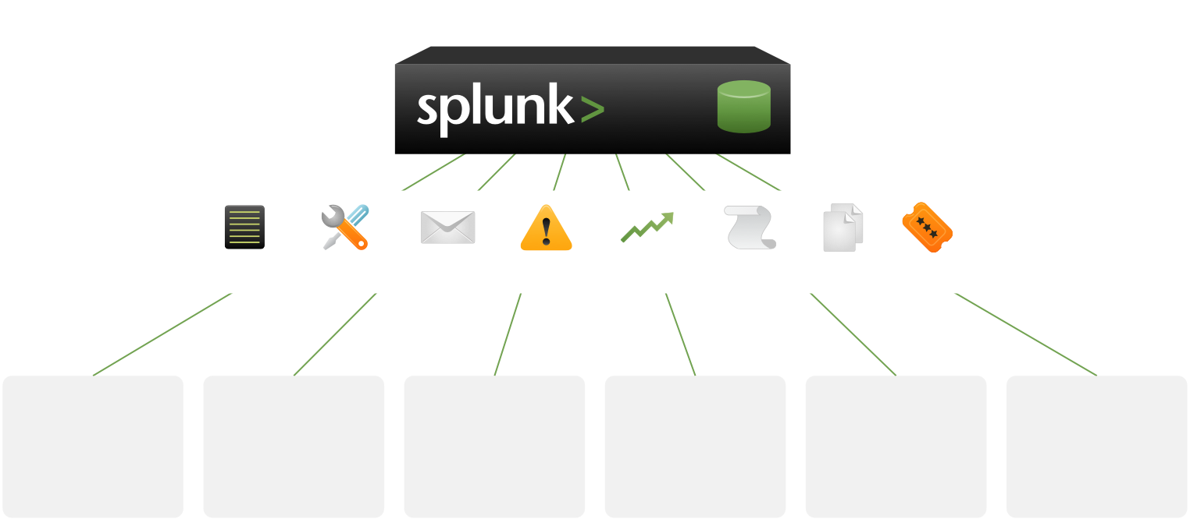
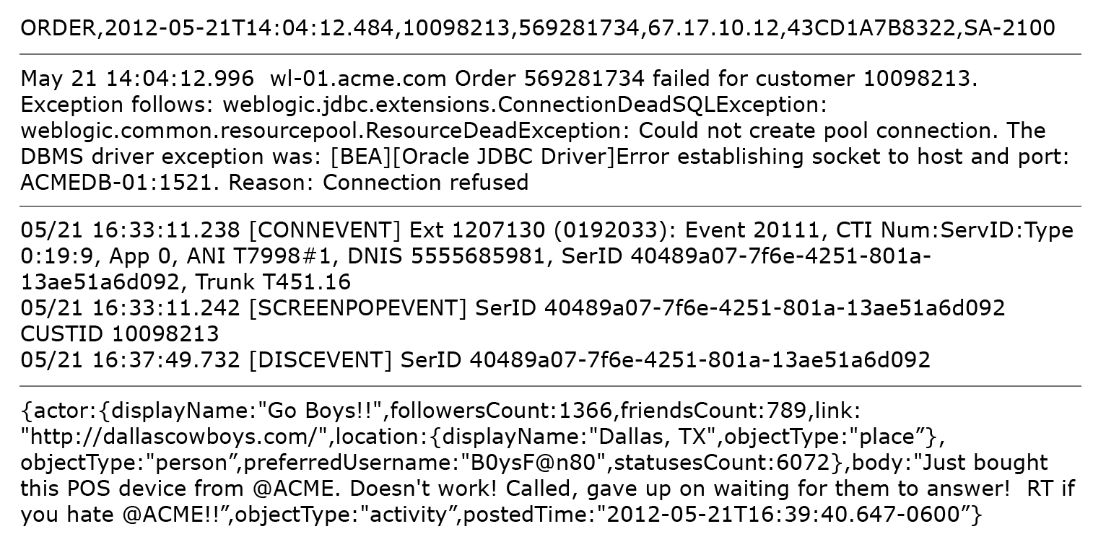



What Does Machine Data Look Like?
Sources
Order Processing
Middleware
Error
Care IVR
Twitter
Notes:
Why is this “machine data” valuable? Because it contains a trace - a categorical record - of user behavior, cyber-security risks, application behavior, service levels, fraudulent activity and customer experience.
Order Processing = Order of a product
Middleware Error = WebLogic Application Server error
Care IVR = Telephone call to complain about the error
Twitter = Comments on the bad experience
This information is very hard and time consuming effort to parse the data for a database consumption. The reason it is very hard to normalize this data is because of the last two Vs = Variety of data + Variability of data (change in format. For example, new fields are added to the log file)

Slide 12
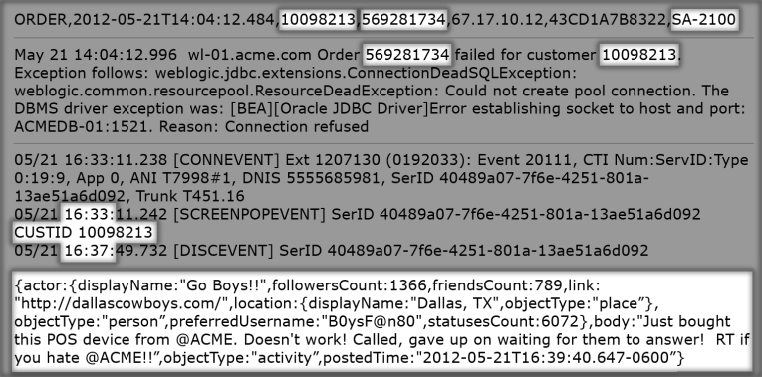
Machine Data Contains Critical Insights
Sources
Customer ID
Order ID
Product ID
Order Processing
Order ID
Customer ID
Middleware
Error
Time Waiting On Hold
Customer ID
Care IVR
Twitter ID
Customer’s Tweet
Twitter
Company’s Twitter ID
Notes:
Example of a Customer ID that Splunk can correlate between the:
Order Processing -> Application Server Error -> Customer calling to complain about the issue -> Twitter record that the customer gave up on waiting

Slide 13
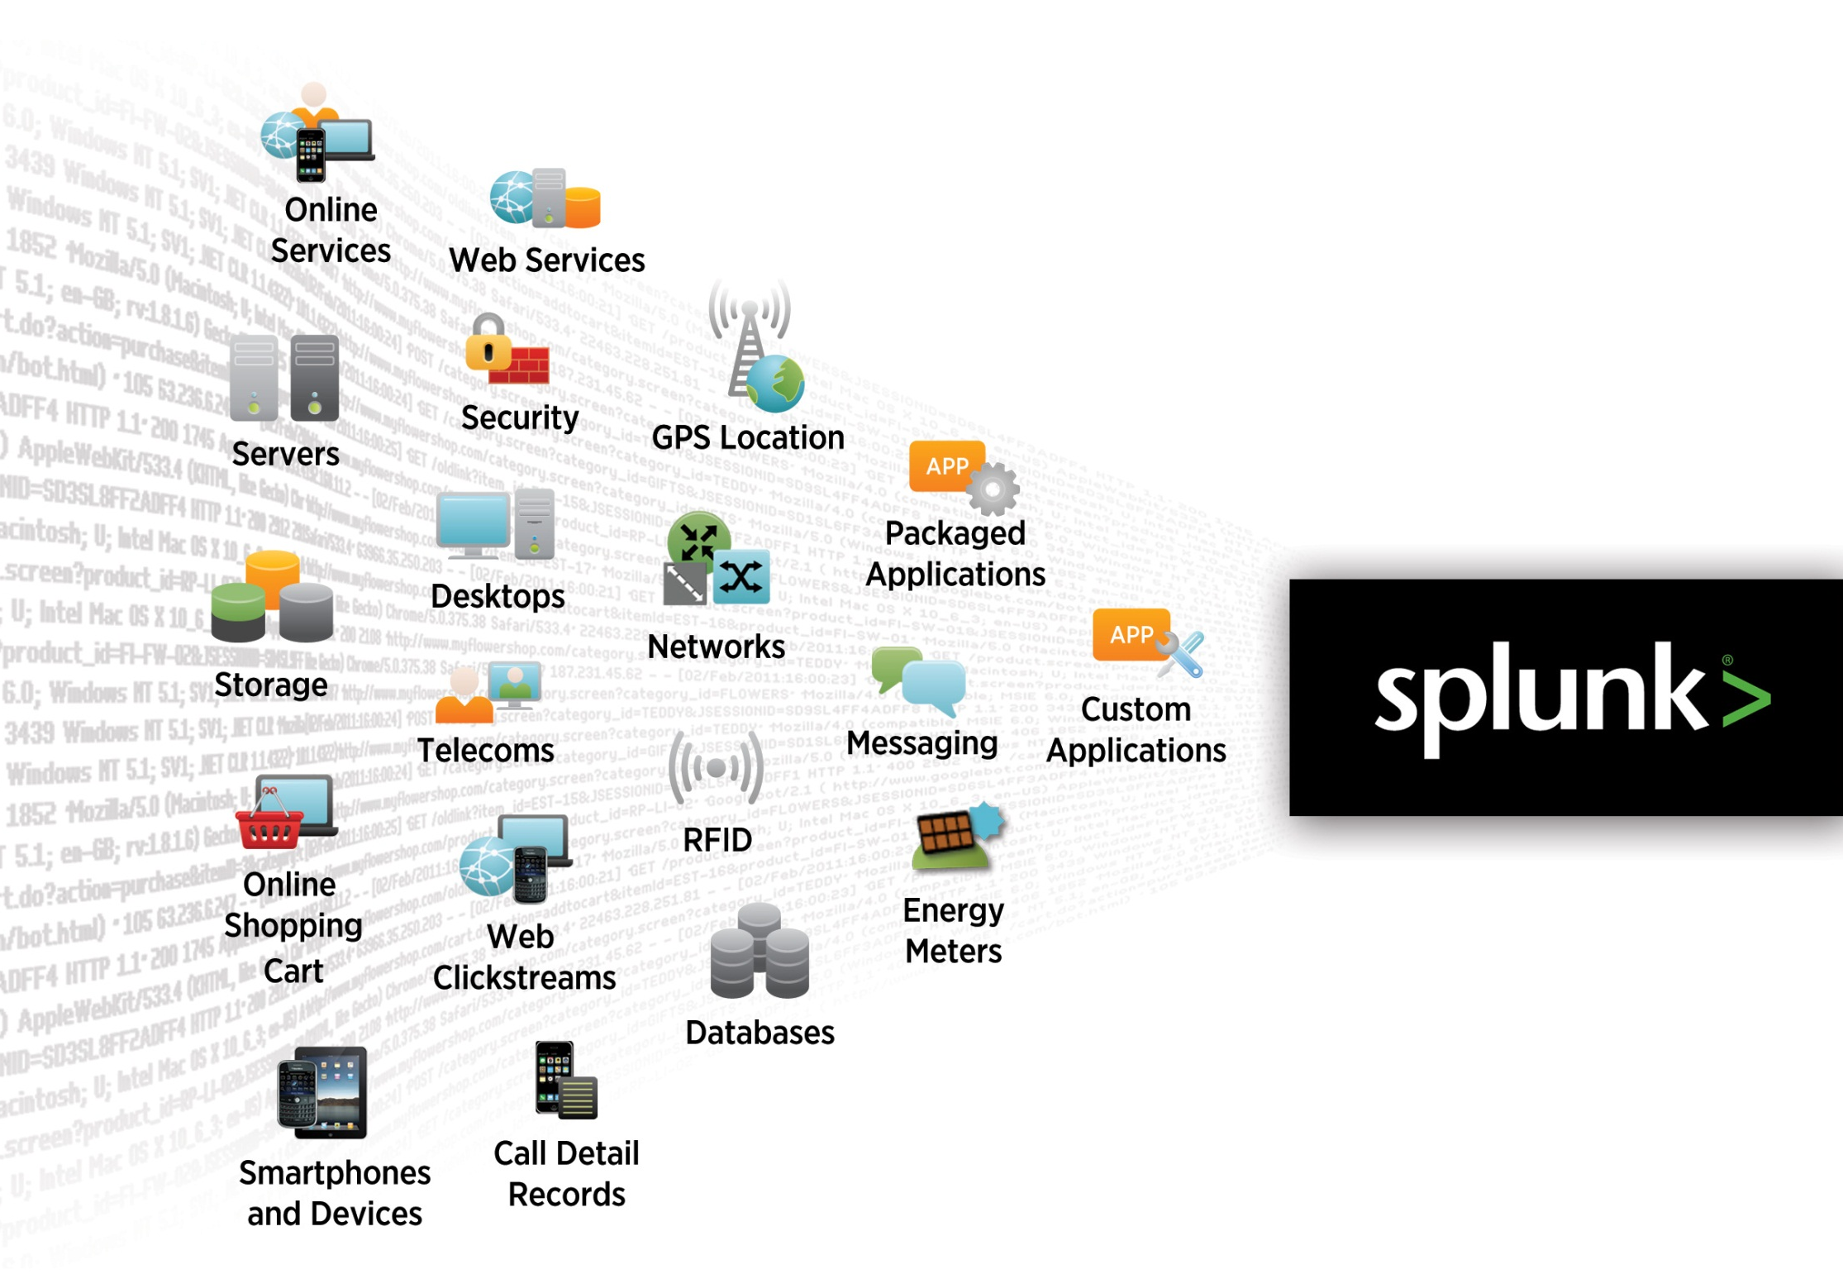

Splunk: The Platform for Machine Data
Machine Data
Operational Intelligence
Insight and Visualizations
for Executives
Statistical Analysis
Proactive Monitoring
Splunk storage - Hadoop
Search and Investigation
Notes:
Splunk is the platform for machine data.
Optimized for real-time, low latency and interactivity
Splunk is the platform for machine data.
It reliably collects and indexes all the streaming data from IT systems and technology devices in real-time - tens of thousands of sources in unpredictable formats and types.
The Splunk platform indexes the data, making it available for searching, monitoring, analysis and visualizations.
It enables you to interact with your data. Gain operational intelligence from your data.
1. Find and fix problems dramatically faster
2. Automatically monitor to identify issues, problems and attacks
3. Gain end-to-end visibility to track and deliver on IT KPIs and make better-informed IT decisions
4. Gain real-time insight from operational data to make better-informed business decisions

Slide 14


Splunk Collects and Indexes Machine Data
No upfront schema. No RDBMS. No custom connectors.
Customer
Facing Data
Outside the Datacenter
Click-stream data
Shopping cart data
Online transaction data
Manufacturing, logistics…
CDRs & IPDRs
Power consumption
RFID data
GPS data
Logfiles
Configs
Messages
Traps
Alerts
Metrics
Scripts
Changes
Tickets
Windows
Linux/Unix
Virtualization
& Cloud
Applications
Databases
Networking
Registry
Event logs
File system
sysinternals
Configurations
syslog
File system
ps, iostat, top
Web logs
Log4J, JMS, JMX
.NET events
Code and scripts
Configurations
Audit/query logs
Tables
Schemas
Configurations
syslog
SNMP
netflow
Hypervisor
Guest OS, Apps
Cloud
14
Notes:
Machine Generated Data will not work if Schema is needed
Splunk stored everything on a simple File system – No RDBMS

Slide 15
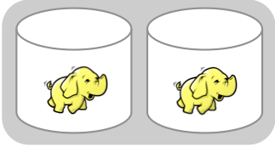

Universal Database Use Case
Splunk visualize and report on Hadoop data
UDB
Forwarder
Refine transactions into readable logs
10s TBs of multi event, multi-line transactions

Slide 16
Before Splunk
100G of data - monitoring and responding to errors cumbersome and prone to false positives
KPI extraction near impossible

Slide 17
UDB After Splunk
Pipe the access logs into Splunk
Find the errors
Build the alarms
Define the KPI
Build the dashboards!
“Universal Database”
Video back office
Notes:
UDB front ends the data collection with HADOOP. Chose Splunk because they can’t get the data out in a useable form.

Slide 18









Splunk Has Four Primary Functions
Searching and Reporting (Search Head)
Indexing and Search Services (Indexer)
Local and Distributed Management (Deployment Server)
Data Collection and Forwarding (Forwarder)
A Splunk install can be one or all roles…
Notes:
Splunk can be divided into four logical functions.
First, from the bottom up, is forwarding. Splunk forwarders come in two packages; the full Splunk distribution or a dedicated “Universal Forwarder”. The full Splunk distribution can be configured to filter data before transmitting, execute scripts locally, or run SplunkWeb. This gives you several options depending on the footprint size your endpoints can tolerate. The universal forwarder is an ultra-lightweight agent designed to collect data in the smallest possible footprint. Both flavors of forwarder come with automatic load balancing, SSL encryption and data compression, and the ability to route data to multiple Splunk instances or third party systems.
To manage your distributed Splunk environment, there is the Deployment Server. Deployment server helps you synchronize the configuration of your search heads during distributed searching, as well as your forwarders to centrally manage your distributed data collection. Of course, Splunk has a simple flat-file configuration system, so feel free to use your own config management tools if your more comfortable with what you already have.
The core of the Splunk infrastructure is indexing. An indexer does two things – it accepts and processes new data, adding it to the index and compressing it on disk. The indexer also services search requests, looking through the data it has via it’s indices and returning the appropriate results to the searcher over a compressed communication channel. Indexers scale out almost limitlessly and with almost no degradation in overall performance, allowing Splunk to scale from single-instance small deployments to truly massive Big Data challenges.
Finally, the Splunk most users see is the search head. This is the webserver and app interpreting engine that provides the primary, web-based user interface. Since most of the data interpretation happens as-needed at search time, the role of the search head is to translate user and app requests into actionable searches for it’s indexer(s) and display the results. The Splunk web UI is highly customizable, either through our own view and app system, or by embedding Splunk searches in your own web apps via includes or our API.

Slide 19


Splunk Components and Scalability
Offload search load to Splunk Search Heads
Auto load-balanced forwarding to as many Splunk Indexers as you need to index terabytes/day
Send data from 1000s of servers using combination of Splunk Forwarders, syslog, WMI, message queues, or other remote protocols
19
Notes:
Splunk uses commodity servers to scale. Splunk customers use the product to harness multiple TB of data per day.
1000s of Forwarders -> Indexers <- Search heads support hundreds or thousands of users all accessing the data

Slide 20

Analyzing Heterogeneous Data
Universal
Indexing
Late Structure Binding
Analysis and Visualization
No data normalization
Automatically handles timestamps
Parsers not required
Index every term & pattern “blindly”
No attempt to “understand” up front
Knowledge applied at search-time
No brittle schema to work around
Multiple views into the same data
Find transactions, patterns and trends
Normalization as it’s needed
Faster implementation
Easy search language
Multiple views into the same data
Rapid time-to-deploy: hours or days
20
Notes:
Data normalization – it’s hard to let go of. For decades we’ve been taking information and chopping it into rows and columns, and then looking up the data by referencing those like a virtual address. Unfortunately, with the radical increase in machine-generated data around most organizations, there aren’t enough skilled people to define how that data should be handled. Like how search overtook directories in how we navigate the Internet, search is the only way to handle so much data, in so many formats, and subject to change without notice.
Universal indexing is a way of handling text based, time series data. Those are the only limitations for Splunk – the data must be text based (or converted into text) and must be orderable into a series. From there, Splunk handles the rest. It finds most timestamps (or creates one), breaks up the raw data stream into discrete events and retains the original data in a compressed form on disk. No normalization, no modification, just a flat-file index on top of the original, now compressed, data.
Search is the where the data is customized for how you want to visualize your IT information. At search time, fields are extracted that can be used like database ‘columns’ to pivot data. If you don’t like the fields Splunk finds, define your own with the graphical field extractor. Then you can create relationships between the rows, using event types to name certain kinds of events for easy aggregation and searching, or define transactions that tie events from multiple systems together into a logical structure. With that limited and easy to create structure, you can find almost any data or pattern across petabytes of information directly from the web UI, without mastering SQL or statistical query languages. Best of all, it’s data your way. Don’t like your search, or your schema? Just re-write or delete it – the data is unchanged. Any user can pivot their lens onto the underlying data without affecting others – unless, of course, they choose to share their knowledge through apps and shared searches.

Slide 21




Real-time Analytics
Data
Real-time Search Process
Monitor Input
Parsing Pipeline
Source, event typing
Character set normalization
Line breaking
Timestamp identification
Regex transforms
Real-time Buffer
TCP/UDP Input
Parsing Queue
Index Queue
Indexing Pipeline
Scripted Input
Splunk
Index
Raw data
Index Files

Slide 22
Splunk Search Processing Language
Lots of random “hypothetical examples” from our Mugs
Notes:
Splunk Search is very similar to Google search - applies for Machine Data.
You want to find happiness, simply type happiness.

Slide 23
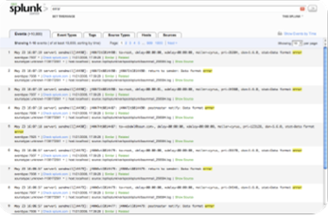
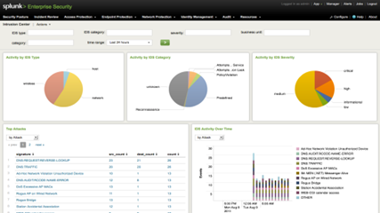
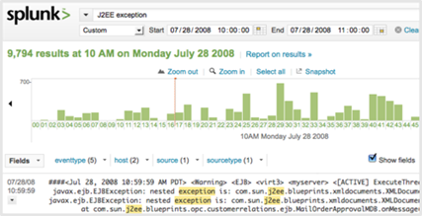
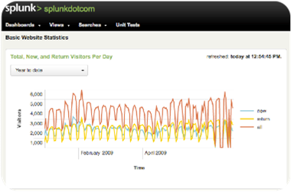
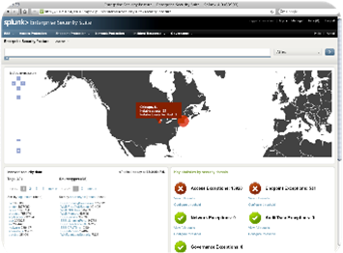
Operational Intelligence for IT and Business Users
IT Operations Management
Web Intelligence
Application Management
Business Analytics
Security & Compliance
Customer
Support
LOB Owners/
Executives
Operations
Teams
Website/Business
Analysts
System
Administrator
IT
Executives
Development
Teams
Security
Analysts
Auditors
Notes:
Splunk can look at the same data from many different angles. People from the IT Operations group, Application Management group, Security, Business Analytics, and Web Intelligence group, can all look at the same source data and derive different information / GUI from the same source.

Slide 24

Better Interoperability Drives Time-to-value
Real-time
Collection and Analysis
Dashboards,
Reports,
Access Controls
Splunk Hadoop Connect
Reliable Data Export
Import Hadoop Data
>
>
Splunk App for HadoopOps
>
>
End-to-end monitoring, troubleshooting , analysis of Hadoop environment
>
>
Notes:
Platforms need to provide better interoperability. And for Hadoop users, we are providing just that. To help address common challenges deploying and running Hadoop.
Splunk Hadoop Connect enables Hadoop users to leverage Splunk to reliably collect massive volumes of machine data. Analyze data in real-time, create visualizations, custom dashboards and protect data with secure role-based access. Then reliably deliver data to Hadoop for ongoing batch analytics. You can also index data stored in Hadoop because once in Splunk, your data’s available for rapid visualization, reporting, analysis and sharing.
The Splunk App for HadoopOps extends what Splunk already does well - troubleshoot and monitor your Hadoop infrastructure. And because it's Splunk it doesn't stop with the Hadoop components, it includes everything. End-to-end. So you get a more complete view of your environment

Slide 25
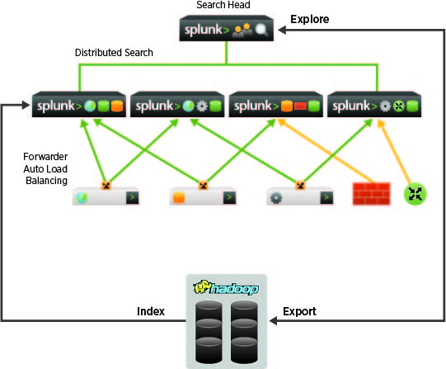
Splunk Hadoop Connect
Delivers reliable integration between Splunk and Hadoop
Export events collected and aggregated in Splunk to HDFS
Explore and browse HDFS directories and files
Import and index data from HDFS for secure searching, reporting, analysis and visualizations in Splunk
Notes:
Splunk Hadoop Connect has three main functions:
Export events to Hadoop – Collect and index massive streams of machine data in real-time using Splunk. Search, analyze and visualize your data and provide secure dashboards to multiple users across your organization. Then send events in a reliable, predictable way to HDFS for archiving, further processing or additional batch analytics. Users have several options when exporting events. They can pre-process data in Splunk before exporting the results into Hadoop, or they can simply export raw events. For example, when processing Apache® web logs, you can limit the data export to just the client IP, session ID and the URL fields.
Explore Hadoop directories and files – Browse and navigate HDFS directories and files from the Splunk Hadoop Connect user interface, before deciding to import data into Splunk. View directories, files names, permissions, sizes and dates of the last modification, all without having to open the actual files. Drill down into a set of directories, examine files and with a click of a button import and index data in Splunk.
Import and Index Hadoop data in Splunk – Address Hadoop limitations, such as the lack of visualizations, limited support for user access controls, and the need for data scientists and specialists to analyze data or to write MapReduce code. Splunk Hadoop Connect detects any updated or new file in the HDFS directory, for example as a result of Sqoop, Hbase or Hadoop commands, and collects and indexes the data. Once in Splunk, your data is immediately available for searching, reporting, analysis and visualizations and protected by role-based access controls.

Slide 26
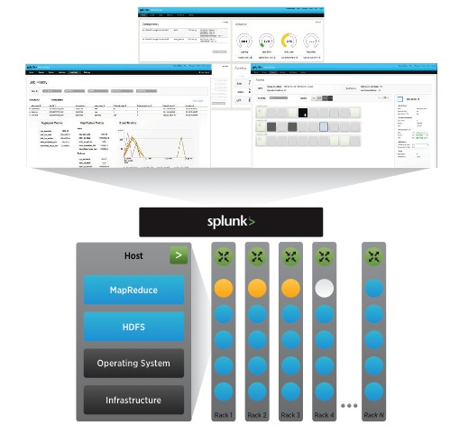
Splunk App for HadoopOps
End-to-end monitoring and troubleshooting for Hadoop
Monitoring of entire Hadoop environment (Network, Switch, Operating System and Database)
Integrated alerting to track and respond to activities from MapReduce to the individual node in the cluster
Centralized real-time view of Hadoop nodes using intuitive heatmap display
Notes:
The Splunk App for HadoopOps provides several specialized features to monitor Hadoop:
Monitoring Nodes on cluster – Display a complete view of all of the servers in the cluster. The monitoring allows Hadoop administrator a view into the health of the cluster, track disk usage, CPU, and RAM from one single view rather then opening multiple consoles for information. Cluster visualization can display a rack or a node specific failure.
Monitoring MapReduce jobs – Displays information on the Map and Reduce tasks. The information here delivers real-time as well as historical statistics as to how the individual tasks are operating and how they are working together. Information gathered here is used to troubleshoot MapReduce performance issues by comparing similar jobs and drilling from JobIDs to TaskIDs. Furthermore, it correlates between used core slots and MapReduce, and pinpoint the MapReduce attempts that are using them.
Monitoring Hadoop Services – Displays information about the health of the Name node, Secondary Name node, and Data node. The services explore HDFS I/O, HDFS capacity per user, HDFS size, and well as the CPU and Memory of the HDFS daemons. Information here is used for monitoring the load and capacity, which can be used to justify hardware and software acquisitions.
View Hadoop Configuration – Displays information about the configuration of each node and each daemon in the Hadoop cluster. Hadoop is highly dependent on the hardware and network it uses. Therefore, any changes made to the Hadoop configurations can create service disruption. The information indexed by Splunk allows Hadoop Administrators to view configurations from HDFS, MapReduce, and the entire surrounding environment, which can lead to producing faster resolution times.
Search Logs – Splunk distributed search and indexing allows for real-time display of information from all Hadoop, Linux, Database, and Network log files to further enhance the end-to-end debugging of issues.
Headlines and Alerts Notifications – Splunk allows for alerts that can be trigger based on a single event as well as a group of events. Per-result Alerting allows users a granular control over the notifications received when one of the Hadoop nodes, MapReduce tasks, or HDFS daemon is failing.

Slide 27
Splunk Big Data Solution
Product-based
Solution
Integrated and
End-to-end
Performance
at scale
Easy to download and deploy
Pre-integrated, end-to-end functionality
Enterprise-grade features
Collects data from tens of thousands of sources
Advanced real-time and historical analysis of data
Fast, custom visualizations for IT and business users
Developer APIs SDKs
Proven at multi-terabyte scale per day
Upwards of PB under management
4,000+ customers

Slide 28

Splunking NBC Olympics Coverage
24x7
Coverage
1,700
Assets
245
Event Replays
27.5M
VOD Views
219M Americans watched NBC's Olympics coverage
Data Splunked 24 hours a day for 21 Days during Olympics
Search VSS: Primary fault detection, alarming and reporting console for all Olympic content

Slide 29
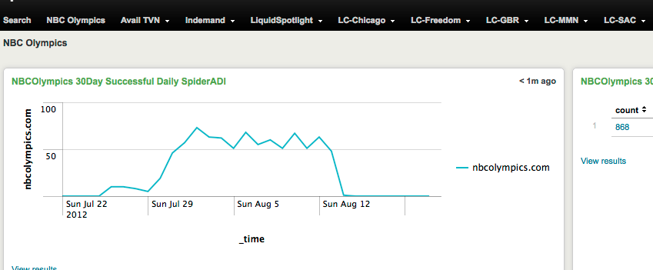
NBC Olympics - Results
Content Management Team
Notes:
Content Management Team supports receiving, ingesting, delivery to the Libraries, Metadata content and End User Menu and Experience
Before Splunk problems were identified and reported by the customer.
With Splunk we monitor each step in the process.
Content providers are allowed only so many errors every month.
Before Splunk they reported to us the number of errors
With Splunk we report to them. Not just the count but what each error was , when it was, and what the impact is. We also get checks back for missing the contracts.
Once Splunk can watch video we will even catch tiled videos.

Slide 30
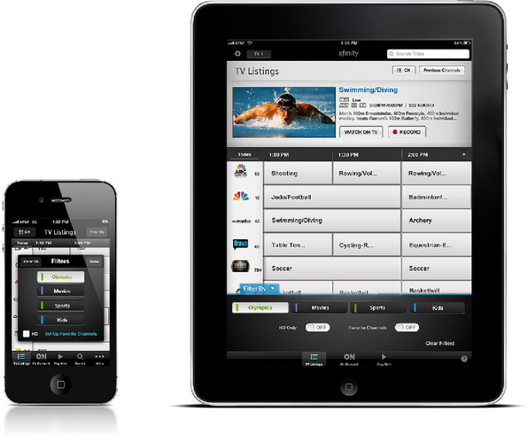
NBC Olympics - Results
On Demand-Online
Real-time watch lists for active content
  How many customers watching what
  Impact of Editorial promotion
  “viral” content
CDN Management
  Finding, reporting, monitoring vendor bugs
CDN Capacity Planning
  Monitoring throughput
  Cache capacity evaluation
  Time-to-serve monitoring
Notes:
Xbox. Real-time watch lists , bug reporting , through put and performance

Slide 31
Comcast – Key Takeaways
Combine technologies to deliver better results – faster
Use Hadoop for batch processing
Use Splunk for real-time processing

Slide 32
Summary - Splunk Big Data Solution
Integrated
end-to-end
real-time
Product-based
solution
Performance
at scale
Come to the Splunk booth to see a demo of new Splunk-Hadoop integrations

Slide 33
Thank You
splunk.com/bigdata

